Slide 1
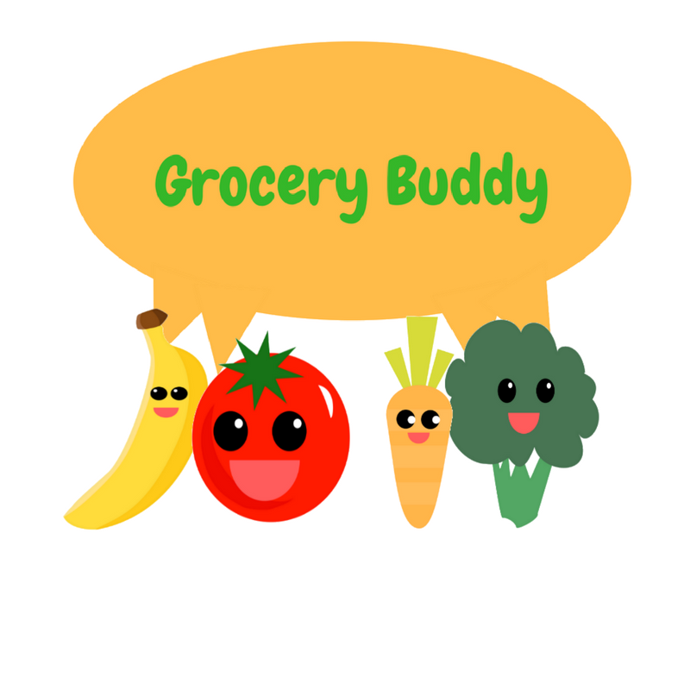
Grocery Buddy
By Ecoders (Patrick, Raly, Kevin, Toni, and Carlo)
Notes:
Raly

Slide 2



What Does It Do?
“Make the most of out what you have”
Plan what you buy – Grocery Lists
Make sure you use it – Fridge expiry trackers and notifications
Notes:
Raly
Our app is called Grocery Buddy, and for those of you that are unfamiliar
Grocery Buddy is a shopping list app that tracks your food products and their expiration dates. It helps you plan what you need to buy and make the most of what you have.
After you checkout items, they appear in your virtual fridge and have their shelf lives displayed as expiration bars, and will notify you of items close to expiring. It helps you plan what you need to buy and make the most of what you have.

Slide 3


Where we left off:
UI draft complete.
Site is Bootstrap responsive.
Angular 4 framework working.
Basic front-end functionality
Notes:
Raly
Last week, we finished Sprint 1 by meeting all of the preset goals that we set for that iteration. We mainly focused on finishing all of the front-end functionality.
We finished designing and implementing our User Interface.
Our app was styled with bootstrap which made it fully responsive.
Our app was built on an Angular 4 environment allowing Single-Page application
And we finished coding all of our front-end functionality with JavaScript and currently have them stored within JavaScript objects.

Slide 4

Sprint 2 Goals: Server Side
Research Data
Integrate with Database - Authentication - User Data (ex: lists) - Read Only Data (ex: expiry dates)
Achieve Full baseline functionality

Slide 5

Sprint 2 Goals: Client Side
Live expiration tracking
Log-in / log-out, account details
UI improvements
Challenge Integration
Notes:
Toni
UI improvements
Gestures
Bug-free
Responsive across all screen sizes

Slide 6
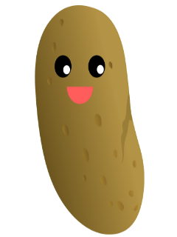

Sprint 2 Challenge:
Site hosting
https://grocerybuddy-fe337.firebaseapp.com/main
Edit affiliates
Take 2
Phoenix Recipes
iPicky
Easter egg

Slide 7
Task assignments:
Kevin - bug-fixing, assisting with database integration
Toni - bug-fixing, assisting with database integration
Raly - Structuring database, syncing client-side functions
Patrick - code port, Firebase integration, gestures
Carlo: easter egg implementation, notifications

Slide 8

Sprint 2 Scrumboard:
Click here!

Slide 9


Conclusion
THANKS!

